Slide 1
FAKE NEWS DETECTION PROJECT
BY DEBANTI ROY

Slide 2
Business Problem Framing
Fake news has become one of the biggest problems of our age. It has serious impact on our online as well as offline discourse. One can even go as far as saying that, to date, fake news poses a clear and present danger to western democracy and stability of the society.

Slide 3
Conceptual Background of the Domain Problem
Fake news's simple meaning is to incorporate information that leads people to the wrong path. Nowadays fake news spreading like water and people share this information without verifying it. This is often done to further or impose certain ideas and is often achieved with political agendas.
For media outlets, the ability to attract viewers to their websites is necessary to generate online advertising revenue. So it is necessary to detect fake news.

Slide 4
Review of Literature
Fake news is false or misleading information presented as news. Fake news often has the aim of damaging the reputation of a person or entity, or making money through advertising revenue.

Slide 5
Motivation for the Problem Undertaken
Fake news is a term that refers to news outlets that pretend to be real but are actually fake. Fake news includes false stories about all sorts of topics that are crafted in order to appear real and get traffic and social shares on Facebook and Twitter.
Our motive is to detect them and make users aware that they are coming across a fake news.

Slide 6
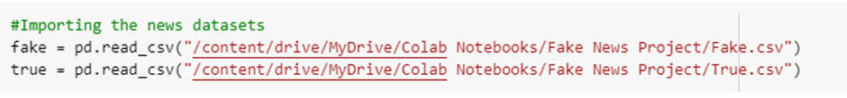
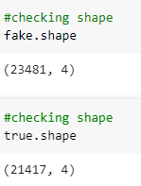
Data Sources and their formats
The datasets are provided to us by Fliprobo. There are two datasets one for fake news and one for true news. Both the files are in CSV format. In true news, there is 21417 news, and in fake news, there is 23481 news.

Slide 7
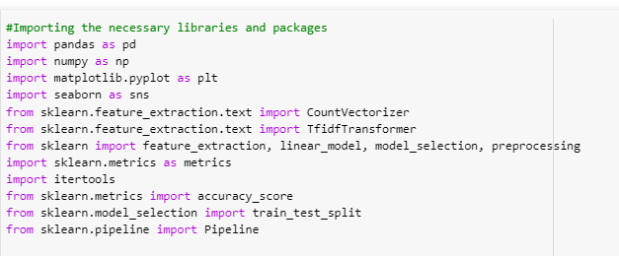
Importing the necessary libraries and packages

Slide 8
Data Preprocessing Done
We added a separate column ‘target’ as flag to identify true and fake news.
We have then concatenated both the fake and true news dataframes into one and then shuffled the data.
We have dropped that date and title columns as they were not necessary for out detection.
Next, we have converted the data into lower case.
We have also removed any punctuation marks from the dataset.
Next, we proceed to remove the stopwords from our dataset.

Slide 9
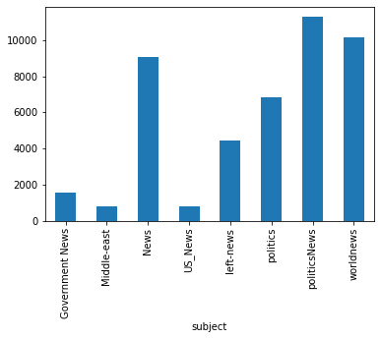
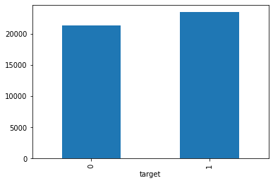
Data visualization
“1” denotes fake and “0” denotes true. We can see there are more fake news.
News count on the basis of subject. There are more political news than any other news.

Slide 10
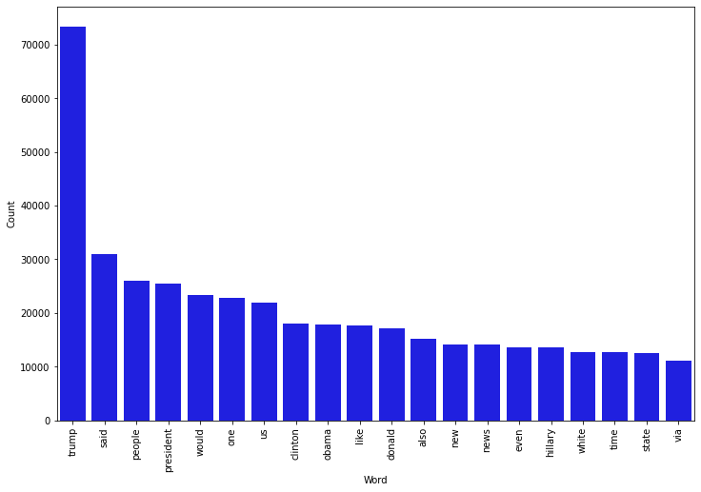
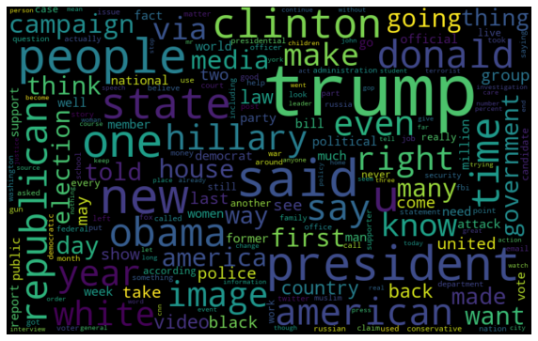
Data visualization
The fake news word cloud shows that words like trump, said, people, president, would, etc. are the most used.

Slide 11
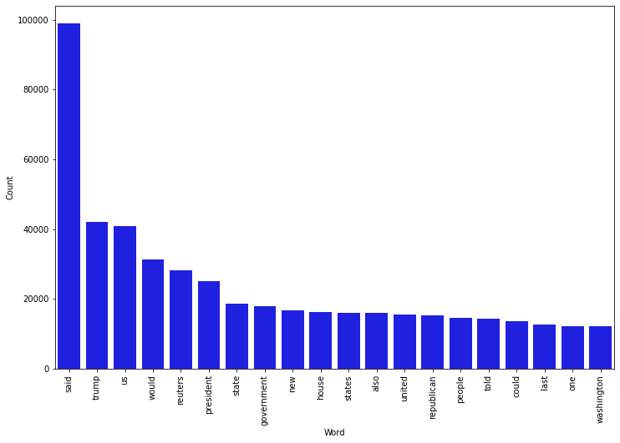
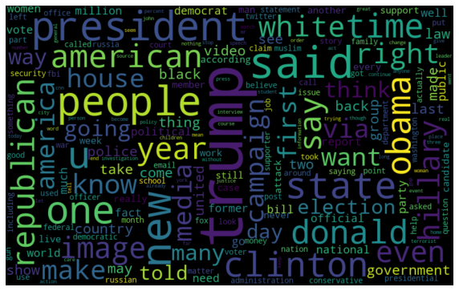
Data visualization
The true news word cloud shows that words like said, trump, us, would, reuters, president etc. are the most
used.

Slide 12
Identification of possible problem-solving approaches (methods)
I have used “.drop()” function to drop unwanted entries in the columns.
Used concat and shuffle functions to concatenate fake and true dataframes into one and then shuffle them.
Performed Lowercase conversion, stopwords removal, punctuation removal, tokenization, etc.
Performed univariant and bivariate analysis using seaborn and matplotlib.
Plotted wordcloud for both fake and true news.

Slide 13
Interpretation of results
Model Name | Model Accuracy
Naïve Bayes | 95.2%
Logistic Regression | 98.99%
Decision Tree | 99.57%
Random Forest | 99.37%
SVM Classifier | 99.6%

Slide 14
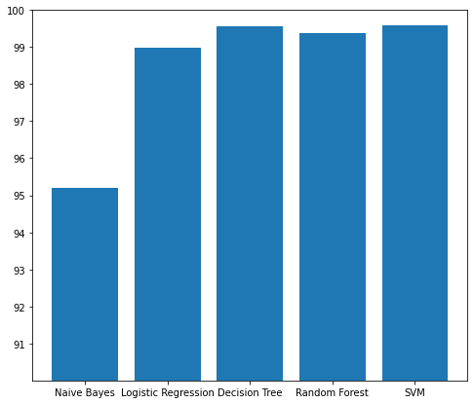
Comparing Different Models
Conclusion:
Through this project I was able to understand the factors that makes the detection of fake and real news easier.
We have tested our data on 5 different models, viz., Naive Bayes, Logistic Regression, Decision Tree, Random Forest and SVM Classifier. We can see that all of them offers an accuracy score more than 95%, however, SVM or Support Vector Classifier offers utmost accuracy which is of 99.6%.

Slide 15


